Slide 1
!Blink
An Online Proctoring Platform

Slide 2




Features of Online Exams
At Home
Provides convenience and comfort
Electronic Devices
Requires technical knowledge
Remote Invigilation
Invigilators can only monitor the examinee remotely
Internet Connection
A strong and stable internet connection is required

Slide 3

Symptoms
Checking answers from other apps or tabs in the computer
Taking help from books or notes or secondary devices
Inefficient Online Exams
Requirement of many invigilators to ensure academic integrity
Proxy test appearance by other people
Problems in communicating with the invigilator

Slide 4
Core Problem
Ensuring academic honesty
Gaining efficiency in proctoring

Slide 5
Solution
!BLINK
An online platform that serves specifically the needs of a virtual exam, and provides additional values to its users further
Our goal is to make academic results fair and justified, while making the invigilation process smooth and easy for the proctors

Slide 6


Product Offerings
Core
Additional
Academic Integrity
Eyeball Tracking
Face Recognition
Monitoring Browser Activities
Exam Features
Uploading Files as Questions
Private Chatting with Invigilator
Conferencing
Easy Proctoring
Immediate Notification of Suspicious Activity
Detailed Report of Examinee Activity
Multiple Screen Recording
Exam Management
Managing Participant Access
Facilitating Exams
Easy Invitation to the Examinees
Multiple Participant Support
Dynamic Session Limit
User Authentication

Slide 7
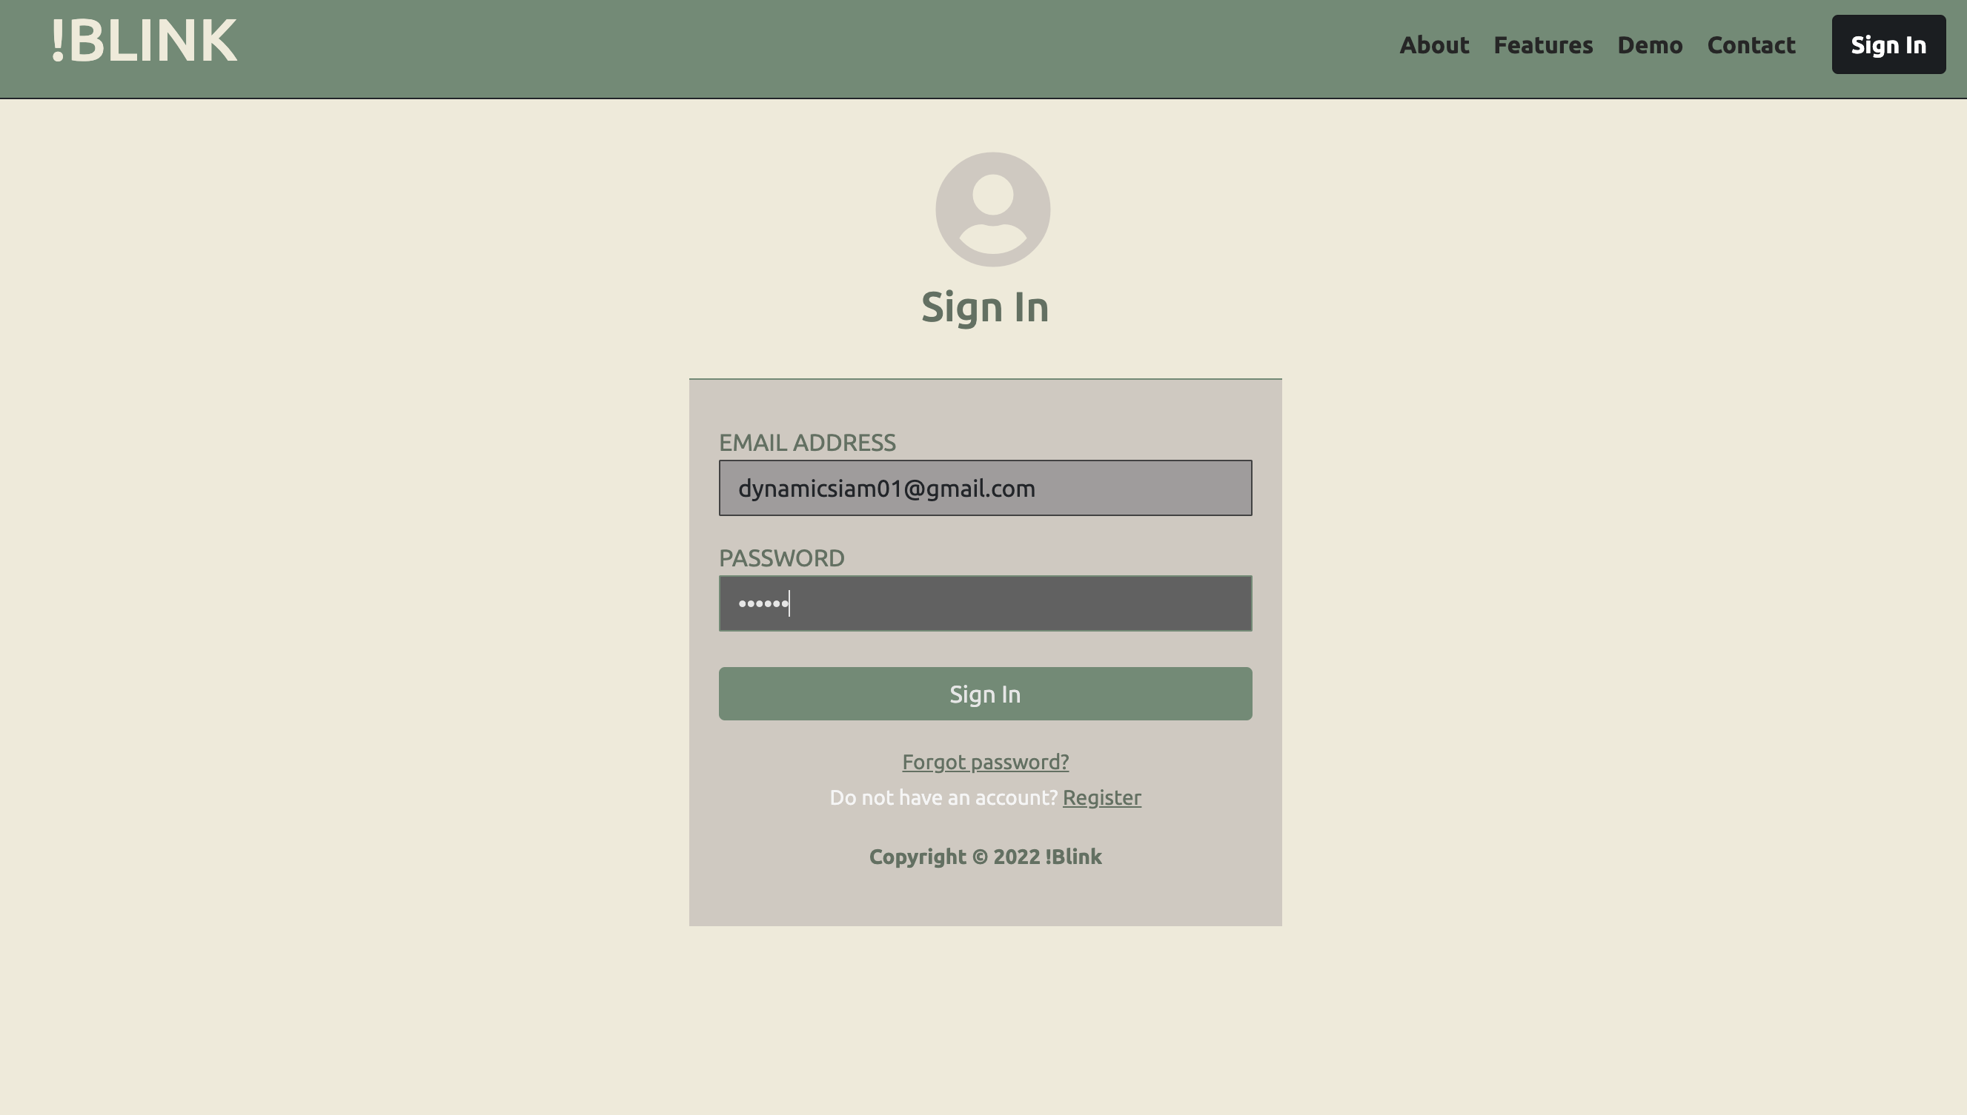
Product Demo - Home

Slide 8
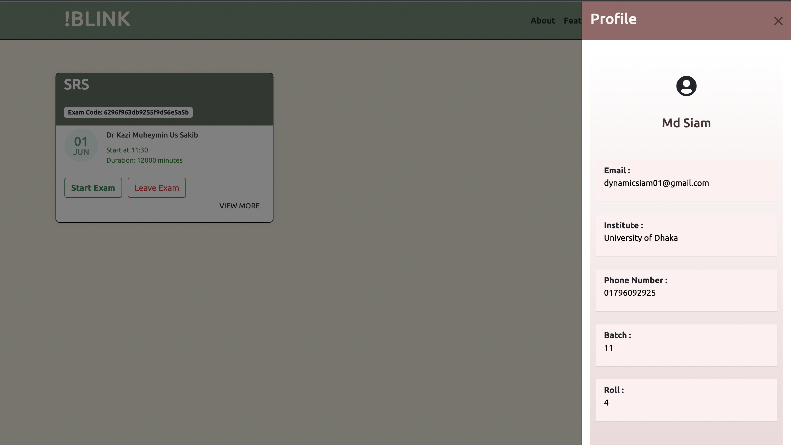
Product Demo – Profile

Slide 9
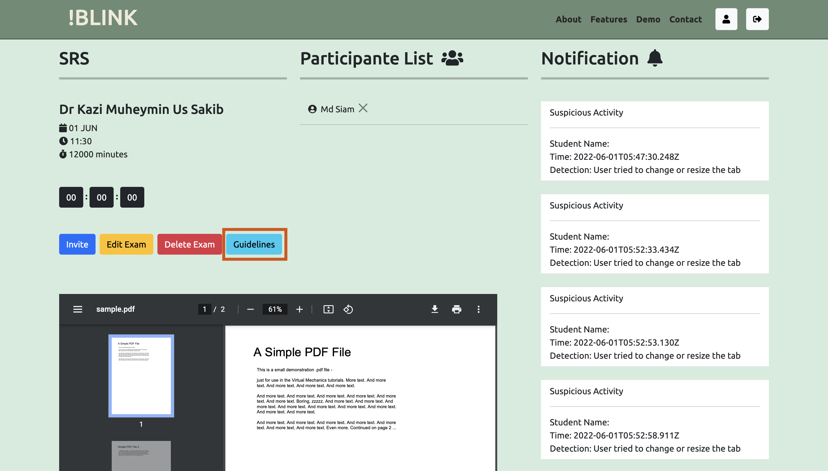
Product Demo – Invigilator’s Screen

Slide 10
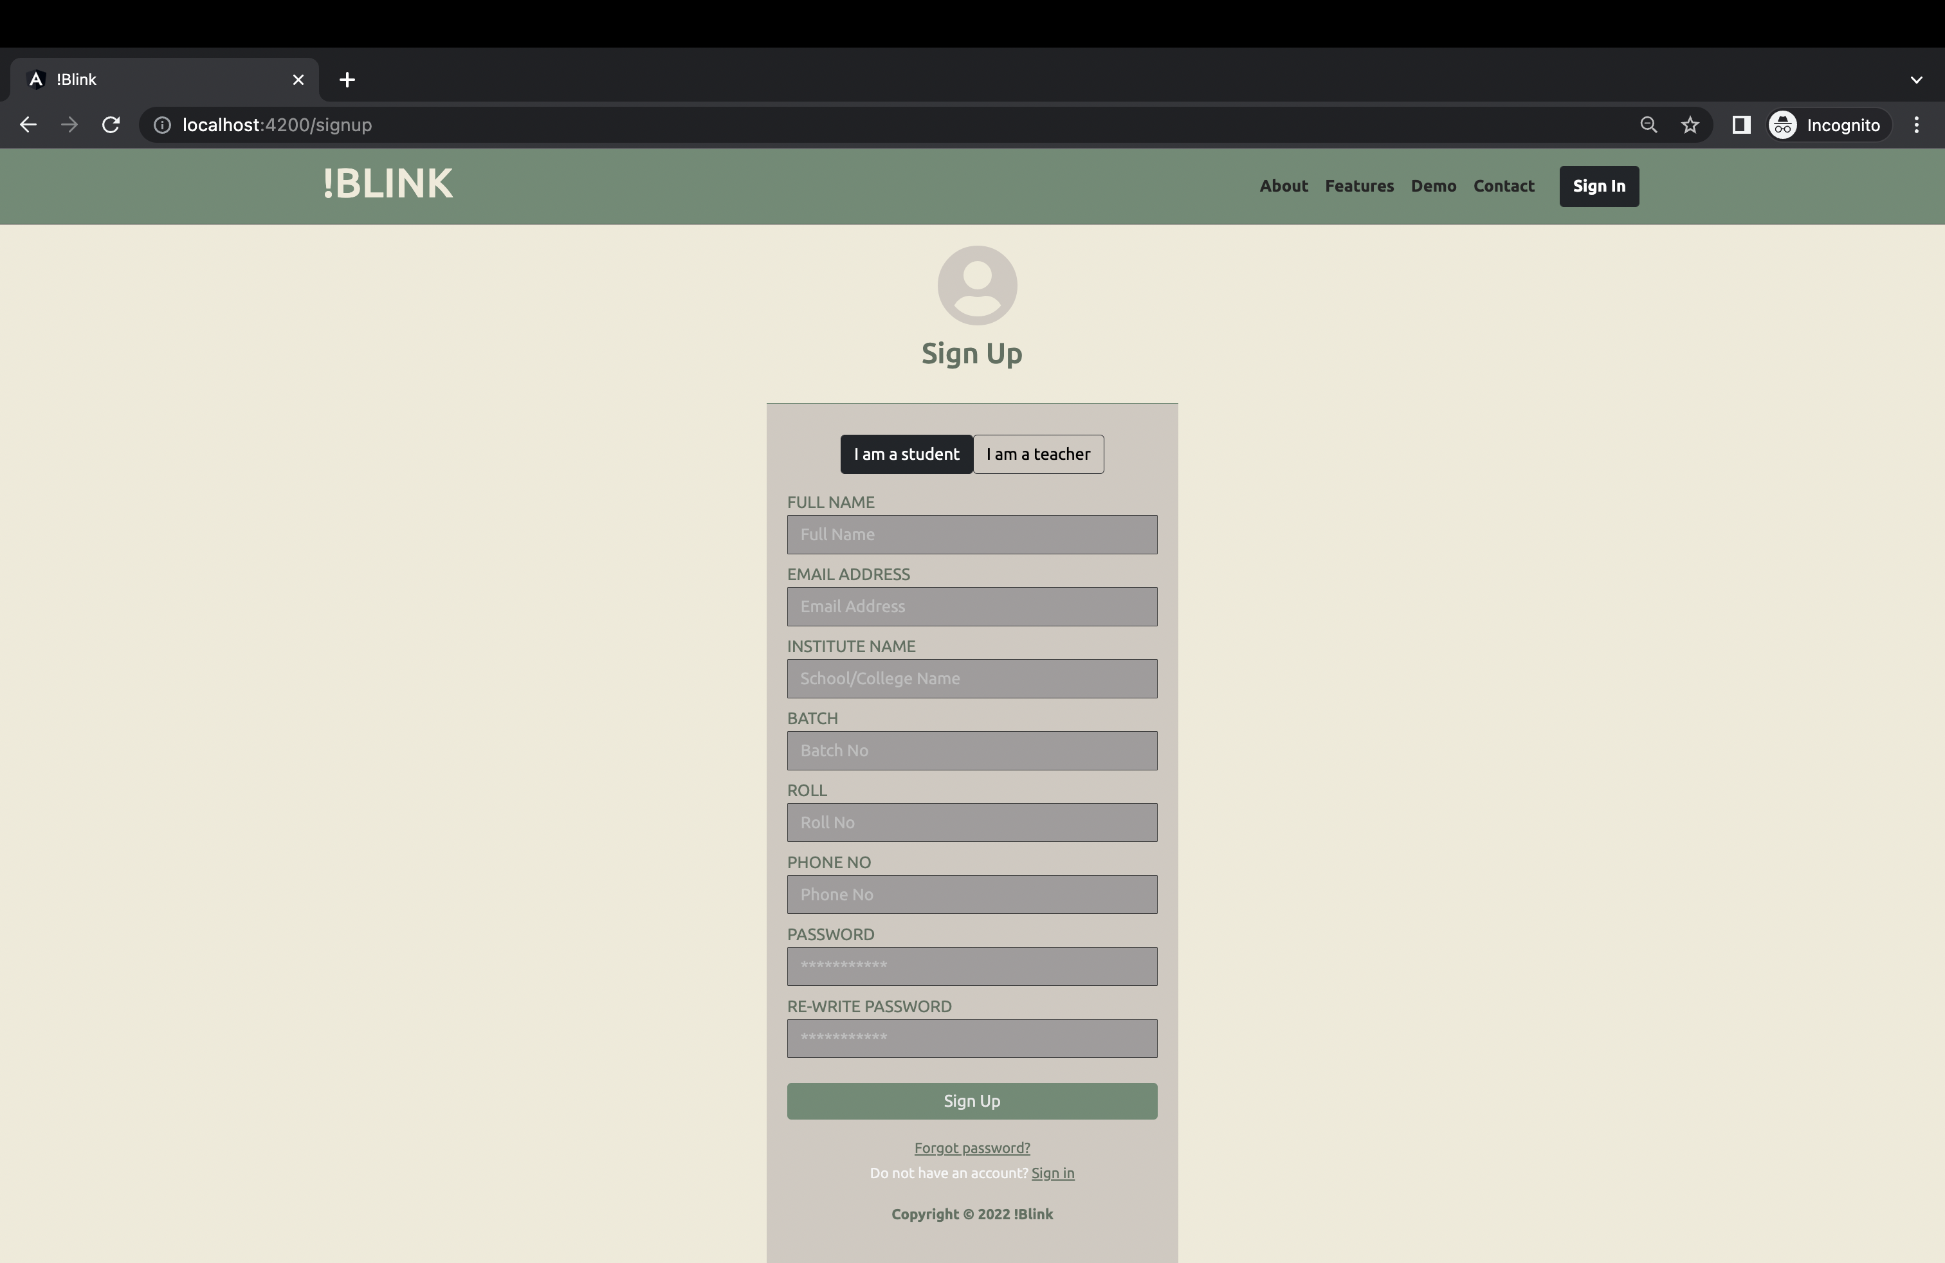
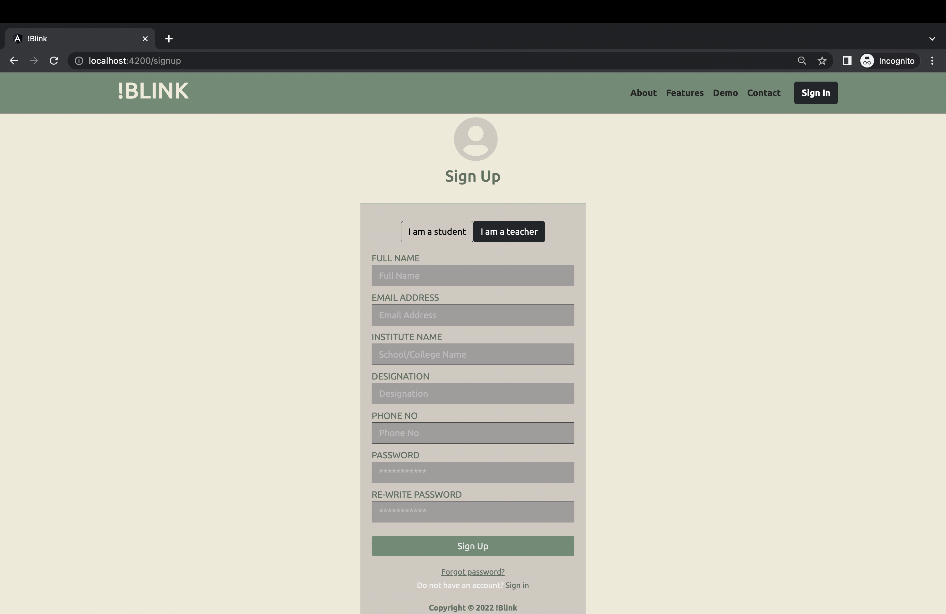
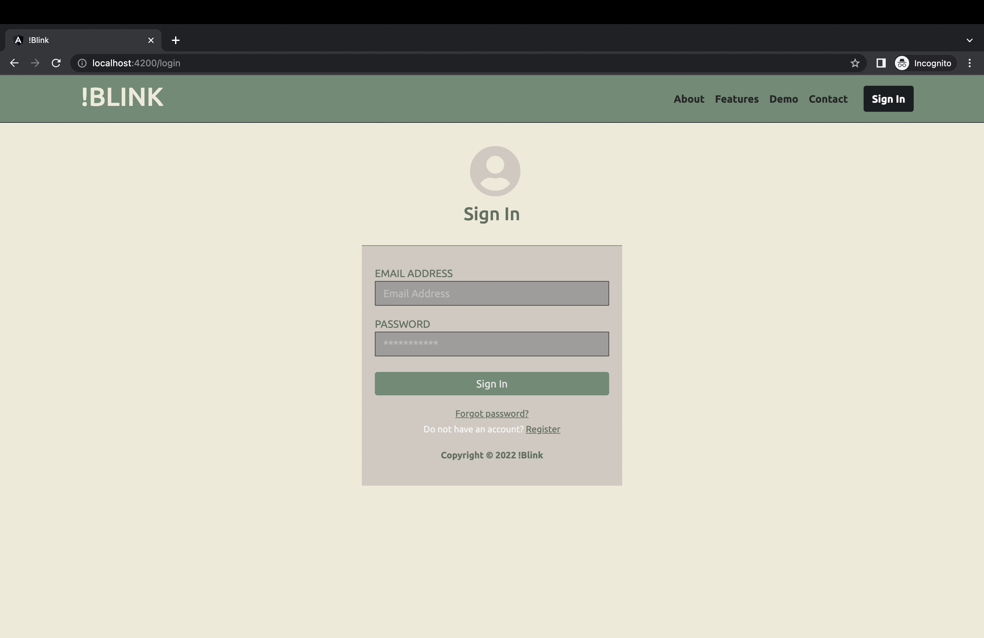
Product Demo – Sign Up and Sign In

Slide 11
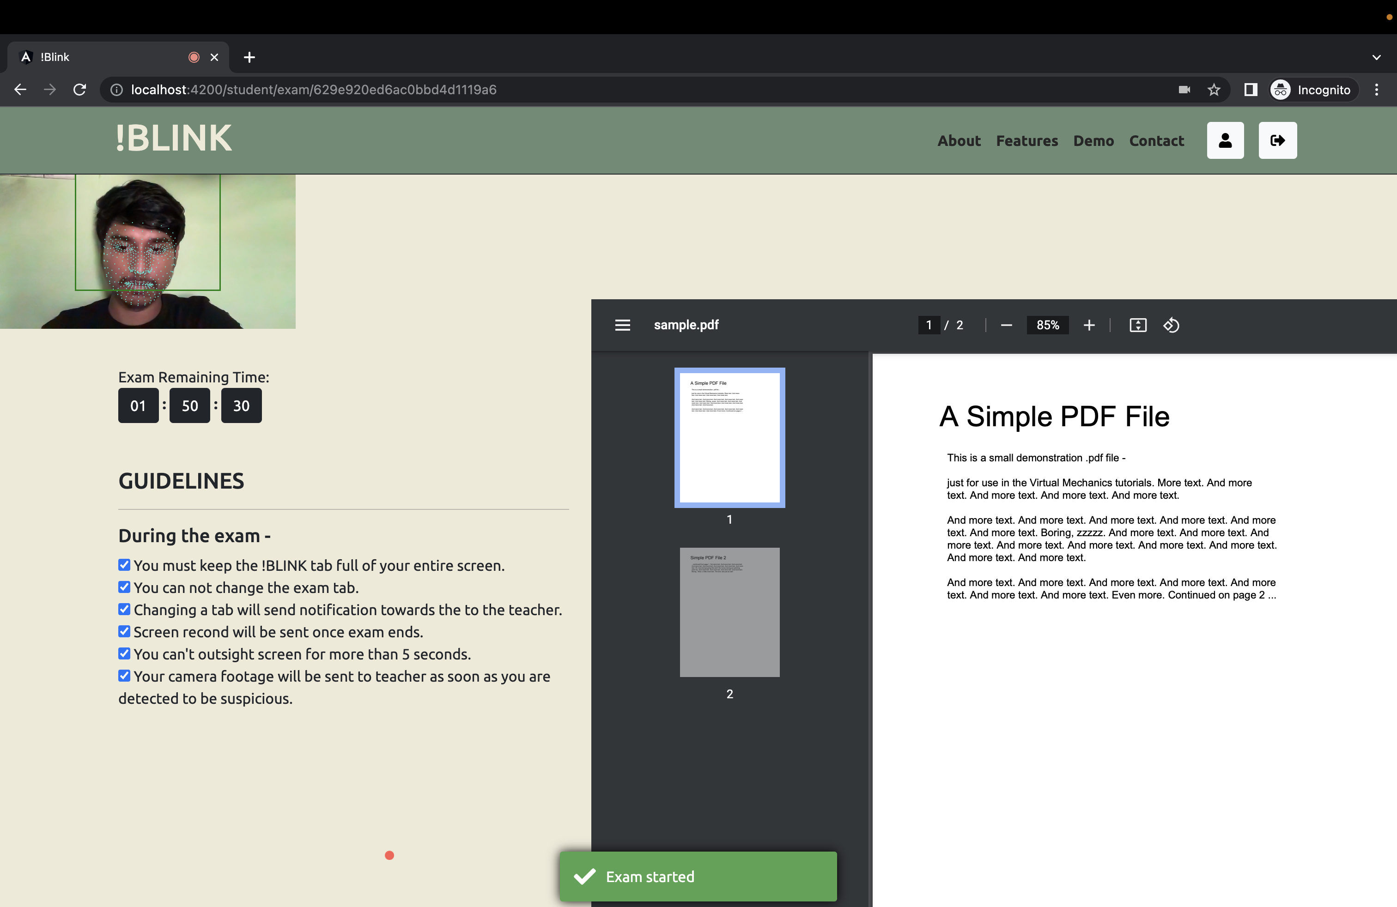
Product Demo – Exam Page

Slide 12
Competitors
Point of Difference

Slide 13
Market
Total Market
52
Public
108
Private
3
Inter.
3,196
College
23.5k
School
??
Coaching
Initial Targets
Universities
English Medium Schools
Top Schools in Dhaka

Slide 14
Thank You

